Slide 1
VANET SECURITY SURYEYS
Published by:
Richard Gilles Engoulou
Martine Bellaïche
Samuel Pierre
Alejandro Quintero
Presented by:
Pavuluri Vamsi Krishna
A20449747
Oklahoma State University
Guided by:
Dr.Anirudh Paranjothi

Slide 2
Outline
Key terms or Keywords
Abstract
Introduction
VANET architecture and characteristics
Challenges
Applications
Security requirements
Security threats
9. Attacker profiles
10. Attack characteristics​
11. Privacy​
12. Security solutions​
13. Global security architecture​
14. Conclusion​
15. Critique ( Critical analysis) on the paper
16. Future scope of the paper

Slide 3
1.Key Terms or Keywords
VANET
MANET
Network Fragmentation
Infotainment
Impersonation
Gateway – Wireless Gateway
Cellular Gateway
Beacon Packets
Public Key Cryptography
Private Key Cryptography
Integrity
Non-Repudiation
Sybil Attack
Peer-to-Peer Networks
Frequency Hopping Technique
Hop, Hop Count, Multi-Hop Network
Single Hop Communication & Single Hop Networks
Trusted Platform Module (TPM)
Packet Drop Attack (or) Black Hole Attack
Eavesdropping
Big-Brother Scenario
Digital Signature
Certificate Authority (CA)
Symmetric Key Encryption
Asymmetric Key Encryption
DOS Attack.

Slide 4
2.Abstract
VANETs, a subset of MANETs, involve smart vehicles communicating wirelessly on roads.
Communication includes vehicle-to-vehicle and vehicle-to-infrastructure interactions.
VANETs improve road safety, enhance vehicle security, and safeguard driver privacy.
Operates on wireless LAN technologies.
VANETs face numerous challenges, especially in ensuring security.
The paper surveys security issues, challenges, and proposes solutions in the context of VANETs.
Introduces categories of applications in VANETs.
Discusses security requirements, threats, and architectural solutions.
Proposes a comprehensive global security architecture for VANETs.

Slide 5
3.Introduction
What is VANET ?
VANET is a Mobile Ad hoc Network (MANET) enabling communication between vehicles
and Road Side Units (RSUs).
Nodes include On-Board Units (OBUs) in vehicles and RSUs along roads.
OBUs are radio devices installed in vehicles that move, while RSUs are placed along the road
and constitute the network infrastructure.
RSUs work as a router between the vehicles. Using Dedicated Short-Range Communication
(DSRC) radios, OBUs can link the vehicle to RSUs.
Distinctions from MANETs:
Notable differences: high node mobility, large-scale networks, dynamic topology,
real-time deadlines, unreliable channels.
Challenges include sporadic connectivity, driver behavior impact, and frequent
network fragmentation.
It is one of the promising approaches to implement Intelligent Transportation Systems (ITS).

Slide 6
VANETs aim to facilitate communication among vehicles on the road. To achieve this, Nodes require radio interfaces, and a dedicated spectrum is essential for VANET data exchange.
VANET Nodes Features:
Nodes require sensors, cameras, GPS, EDR, and omnidirectional antennas.
Essential for efficient communication and decision-making.
VANET Technology Advantages:
Reduces road accidents and enhances driving experience.
Simplifies payment processes for tolls, parking, and fuel.
Applications and Message Exchange:
Various applications address safety, traffic management, and infotainment.
Exchange of messages impacts driver behavior and network security.
Security Concerns and Possible Attacks:
Possible attacks include spreading false information, cheating positioning, disclosure of IDs and other privacy violations.
Security threats encompass traffic jams, Denial-of-Service attacks, and hardware tampering. One common challenge concerns users’ privacy: drivers will not accept to be tracked by a central system ( Big Brother Scenario )

Slide 7
4.VANET architecture and characteristics
Architecture Types:
VANET architecture includes cellular/WLAN, ad hoc, and hybrid architectures.
Cellular/WLAN involves infrastructure like cellular gateways or WLAN access points.
Ad hoc is infrastructure-less, relying on direct communication between nodes.
Hybrid allows nodes to communicate with infrastructures and each other.
Channel Characteristics:
Spectrum allocation for Vehicular Communications (VC) includes 5.850–5.925 GHz in the U.S.
DSRC, based on IEEE 802.11 technology (802.11p), uses a 10 MHz channel with 3-27 Mbps
data rate.
Vehicles send beacon packets at 10 messages per second within a 150m range.

Slide 8
On-board equipment:
On-board equipment transforms vehicles into smart entities facilitating communication.
Components include
Event Data Recorder (EDR),
Global Positioning System (GPS) receiver,
Computing device,
Radars and Sensors,
Omnidirectional antenna, and
Electronic License Plate (ELP).

Slide 9
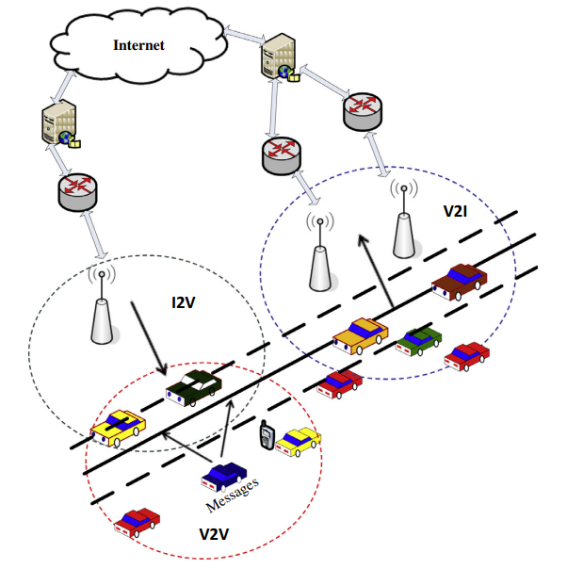
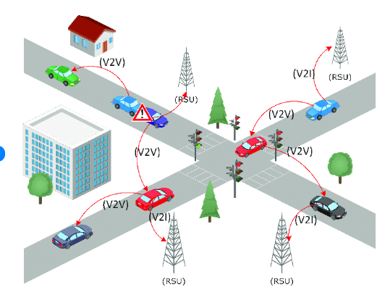
Relationship between Vehicles and their Infrastructures:
Border RSUs vs Simple and Regular RSUs
RSU's management- third-party service providers- having contracts with RTAs
There are three types of communication to consider in VANETs :
Vehicle-to-Vehicle (V2V)
Vehicle-to-Infrastructure (V2I) and
Infrastructure-to-Vehicle (I2V).

Slide 10
5.Challenges
Time constraints
The Scale of the network
The high mobility of nodes
Volatility
Incentives
Cooperation with authorities
These challenges highlight the multifaceted nature of VANETs, involving technical, logistical, and societal considerations. Addressing these issues is vital for the successful implementation and widespread acceptance of VANET technology.

Slide 11
6.Applications
Two main categories:
Intelligent Transport Applications (ITA)
ITA subdivided into:
Transport Safety Applications (TSA)
Transport Efficiency Applications (TEA).
Comfort Applications (CA).
Other potential applications highlighted by Vehicle Safety Communication (VSC) Consortium (formed by government and industry) includes :
Emergency Electronic Brake Lights ( EEBL integrated with CACC)
Pre-Crash Warning
Lane Change Warning etc.,
VANET applications range from safety-critical features to entertainment and comfort services.
Smart vehicles leverage VANETs for real-time communication, contributing to road safety, traffic efficiency, and user satisfaction.

Slide 12
7.Security requirements
Authentication
Integrity
Confidentiality
Non-repudiation
Availability
Access control
Real time constraint
Privacy protection

Slide 13
8.Security threats
Denial of Service
Availability, Real-Time constraints are compromised.
Countermeasures: Switching channels, Authentication
Eavesdropping
Confidentiality is compromised, Encryption is the countermeasure.
Impersonation
Non-Repudiation, Access control are compromised.
Digital signatures & Certificates are countermeasures.
Message falsification/alteration
Impacts Integrity
Countermeasures involve message data verification and detection by unaffected nodes.
Message delay and suppression
Real-Time constraints and availability are compromised
Have to ensure timely message delivery
Hardware tampering
Availability is compromised
TPM is the countermeasure

Slide 14
9.Attacker profiles
Outsider vs Insider
Outsiders are unauthorized nodes, capable of eavesdropping and conducting DOS attacks.
Insiders are two types:
1.Authenticated nodes with full network access – can perform all kinds of attacks.
2.Industrial Insiders – potentially manipulating firmware—Hardware tampering attack.
Malicious vs Rational
Malicious attackers act without a specific goal, aiming to harm the network for pleasure.
Rational attackers have specific targets and may employ impersonation, eavesdropping or message delay/suppression.
Active vs Passive
Active attackers can send harmful messages, with insider status enabling various attacks.
Passive attackers, typically outsiders, eavesdrop on communications to gather information for potential future attacks

Slide 15
10.Attack characteristics
The nature of the attack
The target of the attack
The scope of the attack
The impact of the attack

Slide 16
11.Privacy
One of the greatest challenges in the implementation of VANETs.
Since information is sent via broadcasts in wireless communication, it can be received by any network node. These are privacy-sensitive data (vehicle location, real identity, speed, time) and internal car sensor data.
The goal is to keep the drivers information out of reach of unauthorized observers.
Threats
The trade-off between privacy and security
User's reluctance

Slide 17
Solutions proposed to ensure privacy:
Different solutions are proposed by different authors, some of them are :
Papadimitratos
Pseudonyms-- Certification Authorities(CAs) role
Raya
Set of anonymous keys--changes frequently according to driving speed
A key is used only once--Preloaded in Vehicles TPD, will be changed during yearly checkup.
Dotzer
Proposed a three-phase approach involving pseudonym matching, credential acquisition, credential verification for secure communication.
Lu
Introduces ECPP protocol for anonymous authentication.
Protocol uses short time anonymous keys between OBUs and RSUs
Keys are requested, generated and verified by trusted authority (TA) during communication.
Calandriello
Proposes On-Board Units with a set of pseudonyms(public keys certified by CAs) and the corresponding private keys.
Uses a group signing key for message authentication without revealing individual vehicle identities.

Slide 18
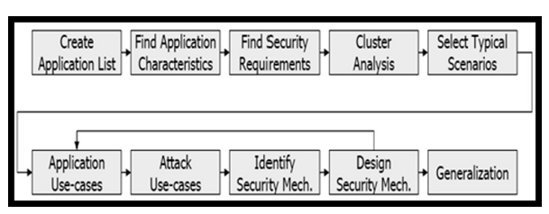
12.Security solutions
Some of the solutions are :
1. Raya:
Solution: Emphasizes digital signatures for authenticating messages in VANETs.
Approach: Proposes using a tamper-proof device to secure private keys and manage cryptographic keys for
user privacy.
Security Measures: Recommends symmetric cryptographic primitives, channel switching, and verification
of received data from multiple sources to prevent attacks.
2. Frank Karl:
Solution: Security-Requirements Engineering using Cluster Analysis (SECA).
Approach: Analyzes a subset of representative applications, applies attack use cases, and derives
required security mechanisms.
Outcome: Identifies security solutions for specific application clusters, allowing for broader application
within each cluster.
Steps of SECA process

Slide 19
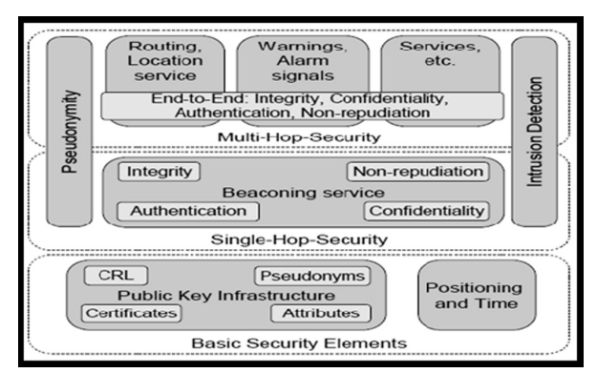
3. Klaus:​
Solution: Security Architecture for VANETs (SAV).​
Model: Three-layered architecture with centralized PKI for user privacy, single-hop security,
and multi-hop ​ layer for various VANET applications.​
Security Features: Digital signatures, CertS verification, and spatial cloak for multi-hop
layer authentication.
Security Architecture for VANET (SAV)

Slide 20
4. Dhurandhar :
Solution: Vehicular Security using Reputation and Plausibility Check Algorithm (VSRP).​
Approach: Utilizes a reputation-based system and sensors for detecting and isolating malicious nodes
during traffic-related events.​
Phases: Covers neighbor discovery, data dispatching, decision making, and trust updates in response
to events like traffic jams and accidents.​
5. Golle :
Solution: General approach for assessing VANET data validity.​
Technique: Nodes search for explanations of collected data, assigning scores to consistent explanations.​
Detection Mechanism: Uses a sensor-driven technique and adversarial parsimony to identify and
score explanations, considering possible Sybil attacks.​
6. Qianhong :
Solution: Security framework in V2V communications for trustworthiness, safety, and privacy.​
Features: Utilizes message linkable group signature (MLGS) to detect Sybil attacks and authentication
through public keys or license plates.​
Revocability: Includes a mechanism by a trusted authority to detect attackers.​
These proposed solutions encompass various aspects of VANET security, addressing authentication, integrity, confidentiality, availability, and privacy concerns.​

Slide 21
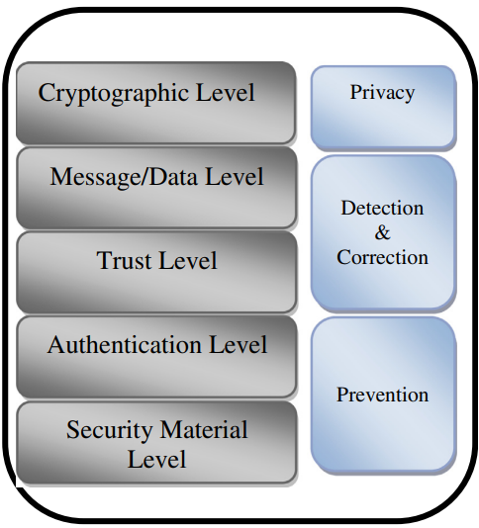
13.Global security architecture
Material Level
Authentication Level
Trust Level
Message/Data Level
Cryptographic level
A generic scheme adaptable to specific systems or
applications rather than a standardized solution.
Global security architecture

Slide 22
14.Conclusion
The paper provides an extensive review of VANET security, covering channel characteristics, challenges, attacker profiles, threats, privacy concerns, and security solutions.
It emphasizes the identification of security issues, adversaries, and proposed architectures in the context of VANETs.

Slide 23
15. Critical analysis on the paper
1.
Significant difference between active and insider nodes, also between passive and outsider nodes should be discussed!
They are looking like same things, as per current description in the paper under attacker profiles section.
2.
In the paper, In the security threats section, under DOS attack, there is one point saying that
" The requirements concerned by this DOS attack consists of data integrity as some messages could be altered due to the non-respect of all of the communication requirements "
But how ?
In DOS attack a node is jammed or blocked either by flooding lot of requests/messages onto this target node, so here availability requirement is violated right then how data integrity requirement is violated?

Slide 24
3.
In the paper, In the security threats section, under message falsification, there is one point saying
" One of the defenses that could be applied in this situation is message data verification, a method that helps to check the data inside the message to ensure that the message is legitimate."
How we can confirm or know whether a particular message is legitimate?
Do we need the same message from neighboring nodes so that we can know whether the message in this node is altered or not? What if neighboring nodes also received false information ?
Authors have to present this point with more clarity, I think.
4.
In many of the security requirements or security solutions proposed by the authors, they proposed some technologies or instruments or devices or techniques to use in order to solve those security issues!
The third-party service providers who provide these technologies ( whether software related or hardware related or network related ) are also might be prone to privacy, data stealing, marketing etc.
So, this can't be avoided, as we definitely need those third-party services in our infrastructure right

Slide 25
5.
Under privacy section one main challenge or concern is:
How can we build a system that will respect users privacy while protecting them from malicious nodes simultaneously?
Big Brother scenario is always present! It's unavoidable right!
If someone from government or legal authorities wantedly can cause privacy violations. They can illegally track driver's identity, driving behavior, the past and present location of the vehicle, payment information for tolls ,etc. for their personal advantage.
So ,we can't achieve 100% privacy !
My suggestion or alternative idea to overcome this challenge or this kind of scenario:
The main problem is only when there is an unwanted security situation or personal damage of the driver right!
So, if we are able to maintain a log file on the legal level i.e., logging information like, which regional authority have accessed which driver (or node) details and when ? And what they used this information for ?
Logging all this at government level should help if in case any unwanted/malicious situations arise from legal side.
one can in future can track what exactly happened, how the driver's privacy information misused by any person of legal/government authority. So, we can be able to find the culprit as well, in such cases.

Slide 26
6.
Under VANET architecture and characteristics, authors mentioned that
"A pure ad hoc architecture is the one where no infrastructure is available, and so the nodes must communicate with one another without relying on an infrastructure."
In this pure ad hoc architecture mentioned, how they communicate with one another without any infrastructure?
I mean without any gateways, how they (nodes) communicate or how routing of packets takes place ?
Is it either by satellite connection (or) Is it like by maintaining routers kind of devices in the nodes (vehicles) itself? Need clarity from authors on how this communication could takes place!
7.
In the global security architecture proposed by authors, they only given overall brief about how the architecture should look like or should consists of.
But they did not mention which method (or security solution method) to exactly implement at some levels in the architecture proposed.
It just giving an overall view of, how the system could be!

Slide 27
8.
In the paper under Section "2.1 Channel characteristics", there is an ambiguity in the bandwidth, whether is it 10 MHz or 75 MHz for DSRC?
Authors have to make this point clear!
9.
Under Section "4. Applications ", at the end author's mentioned that
"Comfort applications can be accessed without an Internet connection. These applications pertain to weather information, interactive communication, information related to facilities such as hotels, gas stations, restaurants, payment services etc."
How do we get the current weather information without Internet ?
How interactive communication possible without internet?
Is it via mobile or government emergency satellite communication or via some offline apps?
Need clarity!
10.
In security threats, some details on attacker profiles are included.
It could be better if authors put attacker profiles section before the security threats section, instead they placed it after in the current paper.

Slide 28
Positives
Comprehensive coverage
The paper provides a comprehensive overview of VANET security, encompassing various aspects such as channel characteristics, challenges, attackers profiles, threats and security solutions.
This breadth is essential for readers seeking a holistic understanding of the topic.
Technical details
The paper demonstrates a strong technical understanding of VANET security, providing in-depth discussions on cryptographic protocols, authentication mechanisms, security challenges & proposed solutions and privacy-preserving techniques .
This technical depth is valuable for researchers and practitioners in the field.
Clear structure
The paper follows a clear and organized structure, dividing the content into well-defined sections.
This structure enhances readability and helps readers follow the logical flow of information.
Visual aids
The inclusion of figures, such as the global security architecture diagram, contributes to the clarity of complex concepts.
Visual aids are effective in conveying intricate details and relationships between different security levels.
Up-to-Date references
The paper references various studies, protocols and standards, indicating an awareness of the latest developments in VANET security.
This is essential in a rapidly evolving field.

Slide 29
Negatives
Lack of critical analysis
The paper could benefit from a more critical analysis of proposed security solutions.
While it presents various techniques, a discussion on potential limitations, challenges, or drawbacks of these approaches would provide a more balanced perspective.
Theoretical emphasis
The focus on theoretical aspects of security solutions is prominent, but the paper lacks discussions on practical considerations and implementation challenges.
Real-world implications and feasibility considerations are crucial for industry and deployment scenarios.
Limited practical insights
The paper does not extensively discuss practical implications or offer insights into the real-world application of the proposed security measures.
Practical considerations, such as deployment challenges, are essential for translating theoretical solutions into actionable strategies.
Future directions missing
The paper does not explore future directions or emerging trends in VANET security.
Including insights into potential advancements or areas for further research would inspire future work in the field.

Slide 30
16. Future scope of the paper
1. Integration of Blockchain Technology:
Investigate the potential integration of blockchain technology into VANET security.
Blockchain's decentralized and tamper-resistant nature could enhance the trustworthiness of data in VANETs.
2. Machine Learning for Anomaly Detection:
Explore the application of machine learning algorithms for anomaly detection in VANETs.
ML models can learn normal behavior patterns and identify deviations, improving the ability to detect malicious activities.
3. Real-world Implementation Challenges:
Discuss practical implementation challenges and considerations for deploying security measures in real-world VANET scenarios.
This could include factors like cost, infrastructure requirements, and interoperability with existing transportation systems.
4. Standardization Efforts:
Explore and discuss ongoing or proposed standardization efforts related to VANET security.
Understanding industry standards and protocols is essential for ensuring interoperability and widespread adoption.

Slide 31
5. Privacy-Preserving Techniques:
Delve deeper into privacy-preserving techniques and assess their effectiveness in real-world scenarios.
Consider the trade-offs between privacy and security and explore innovative approaches to strike a balance.
6. Community Feedback, Global Perspectives and Case Studies:
Seek community feedback on proposed security solutions and include case studies or examples of successful VANET security implementations.
Provide a global perspective on VANET security by including case studies from different regions. Analyze how security challenges and solutions vary based on geographical, cultural, or regulatory differences.
Real-world experiences and lessons learned can provide valuable insights for researchers and practitioners.
7. Cross-Domain Collaboration:
Explore opportunities for cross-domain collaboration, especially with experts from related fields such as IoT security, vehicular communications, and network security.
Interdisciplinary collaboration can lead to holistic and innovative security solutions.
8. Energy Efficiency Considerations:
Investigate the energy efficiency aspects of security measures in VANETs, especially considering the resource constraints of vehicular devices.
Optimize security protocols to minimize energy consumption.

Slide 32









